Slide 1
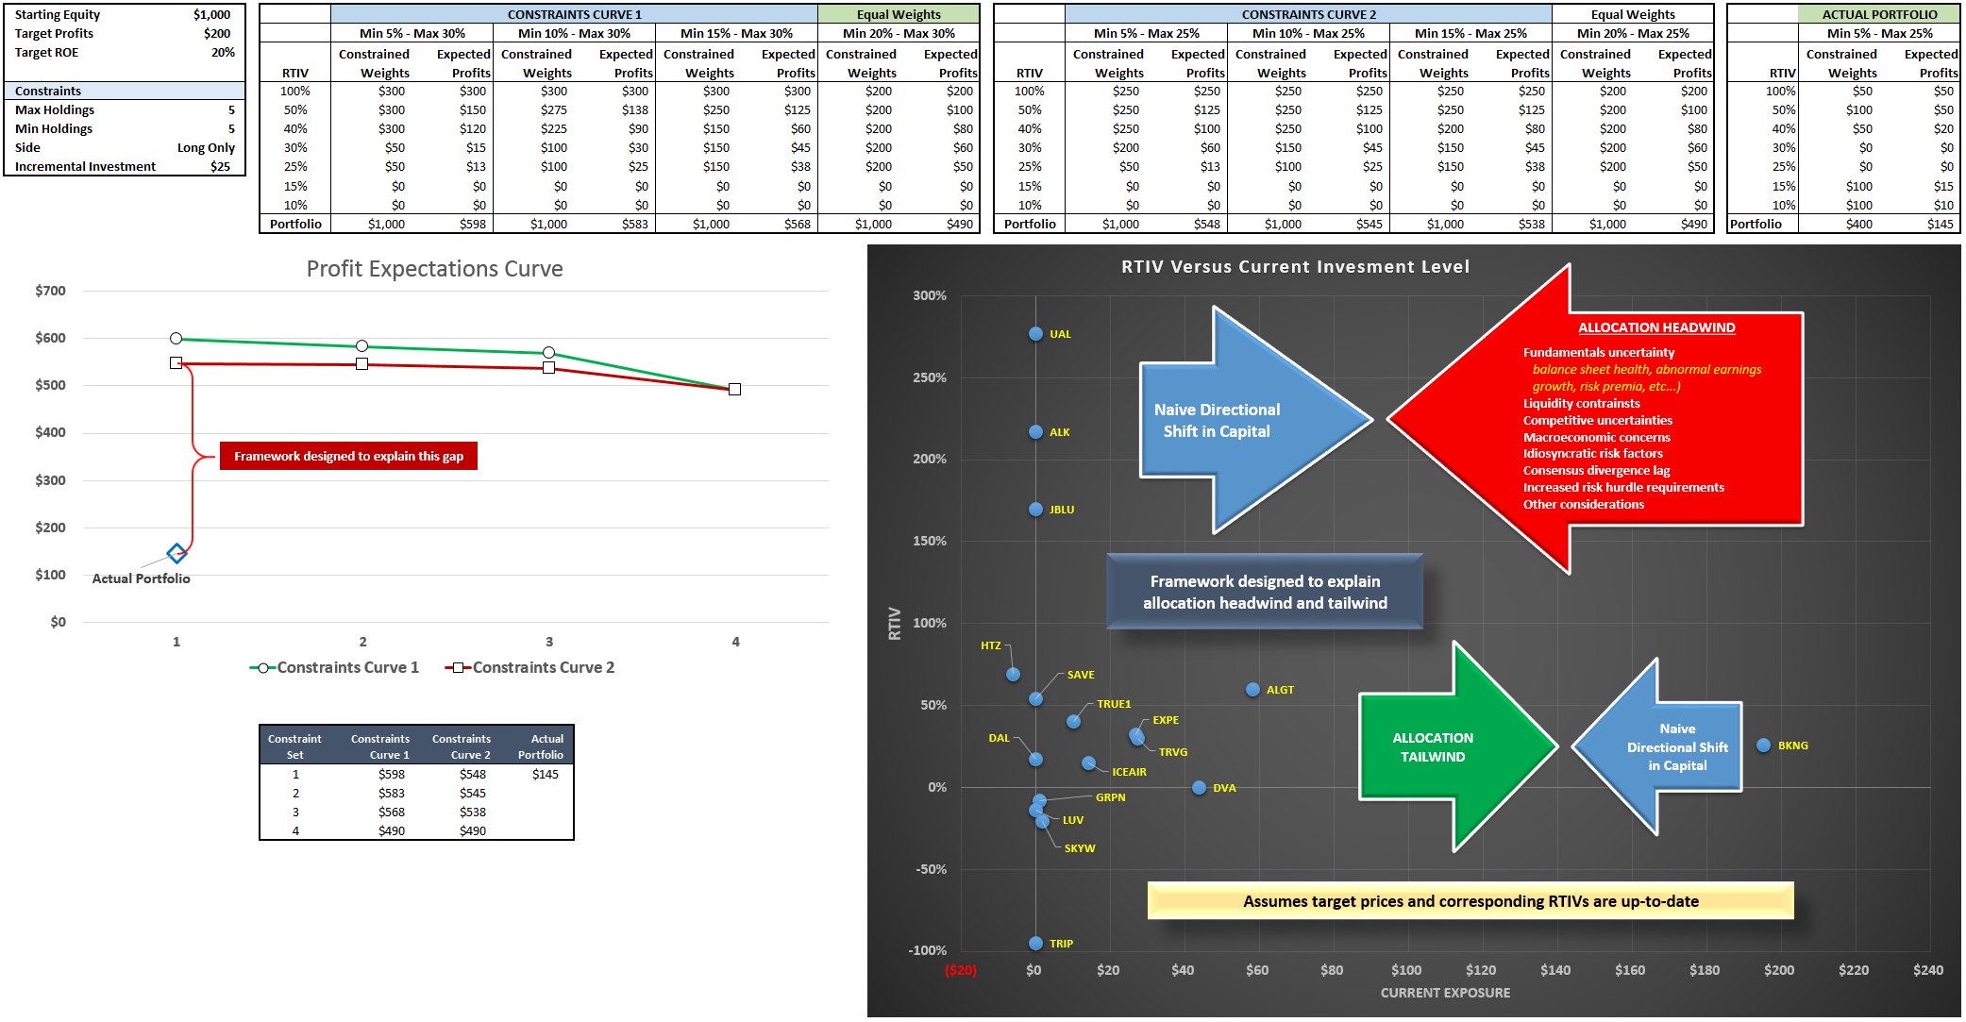
First Bullet Point – RTIV Framework

Slide 2
Second Bullet Point – Trading Impact
Trading Impact Report delivered daily for all manager and all names (currently Paul’s portfolio is being used as the prototype)
Reformulation for tracking of “new ideas”
Side bar tracking of transient trading

Slide 3
Third Bullet Point – Broad Market Comparisons
Track current market pattern versus prior seven historical 252 session bear markets (minimum 25% drawdown in 23 trading sessions, history from 1927 to present)
Provide concrete comprehensive data framework on macroeconomic indicators in conjunction with market patterns
GDP, GNP, NNI, government/private consumption, investment
Unemployment
Budget balance, deficit, surplus
Statistics: consumer, business, industry
Money and financial markets
Prices and wages
With growing awareness and consumption of macro data, introduce basic prognostication framework

